Slide 1
Getting Specific Formats out of LLMs
Plain text outputs are useful, but there may be use cases where you need the LLM to generate a structured output—that is, output in a machine-readable format, such as JSON, XML, CSV, or even in a programming language such as Python or JavaScript.
This is very useful when you intend to hand that output off to some other piece of code, making an LLM play a part in your larger application.

Slide 2
JSON Output
The most common format to generate with LLMs is JSON. JSON outputs can (for example) be sent to your frontend code or be saved to a database.
When generating JSON, the first task is to define the schema you want the LLM to respect when producing the output. Then, you should include that schema in the prompt, along with the text you want to use as the source.
Let’s See An Example ->

Slide 3
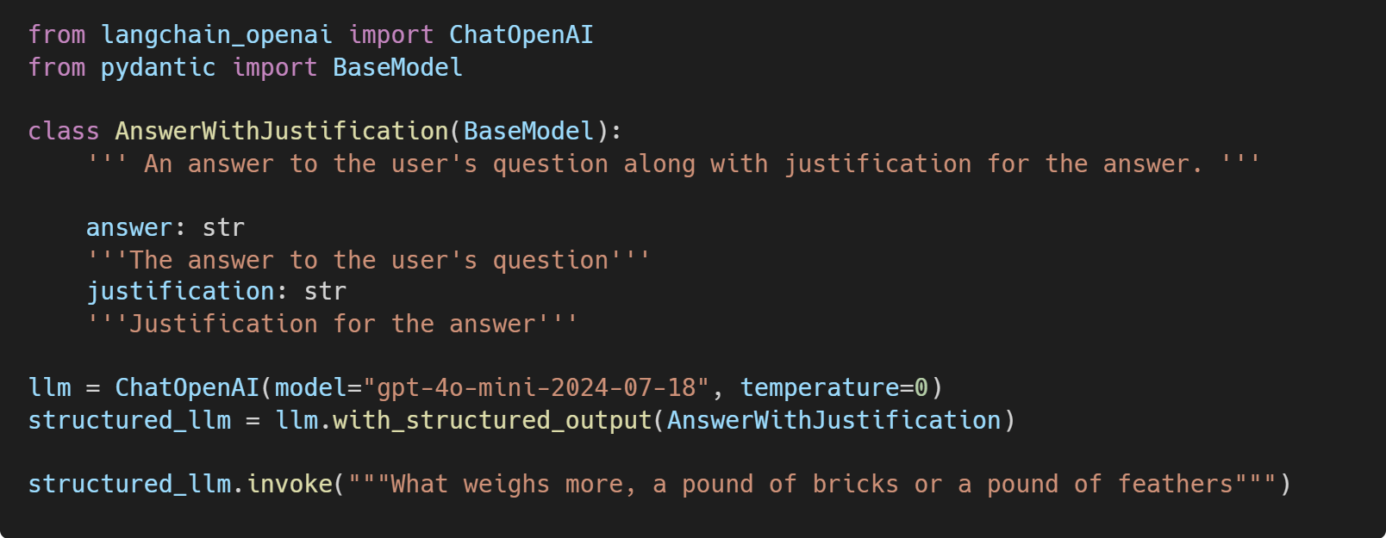
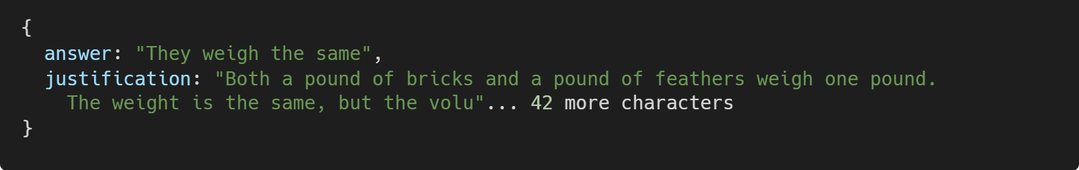
Python
The output:

Slide 4
First, Define a Schema
In Python, this is easiest to do with Pydantic (a library used for validating data against schemas).
In JS, this is easiest to do with Zod (an equivalent library).
The method with_structured_output will use that schema for two things:
The schema will be converted to a JSONSchema object (a JSON format used to describe the shape [types, names, descriptions] of JSON data), which will be sent to the LLM. For each LLM, LangChain picks the best method to do this, usually function calling or prompting.
The schema will also be used to validate the output returned by the LLM before returning it; this ensures the output produced respects the schema you passed in exactly.

Slide 5
Other Machine-Readable Formats with Output Parsers
You can also use an LLM or chat model to produce output in other formats, such as CSV or XML. This is where output parsers come in handy. Output parsers are classes that help you structure large language model responses. They serve two functions:
Providing format instructions
Output parsers can be used to inject some additional instructions in the prompt that will help guide the LLM to output text in the format it knows how to parse.
Validating and parsing output
The main function is to take the textual output of the LLM or chat model and render it to a more structured format, such as a list, XML, or other format. This can include removing extraneous information, correcting incomplete output, and validating the parsed values.

Slide 6
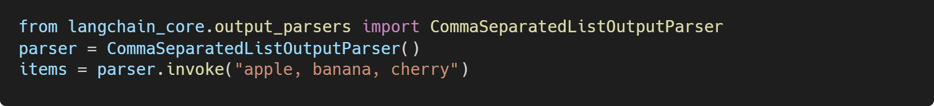
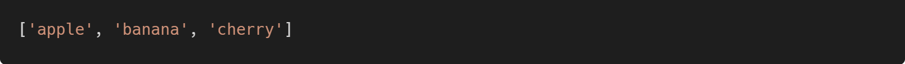
Here’s an example of how an output parser works:
Python
The output:
LangChain provides a variety of output parsers for various use cases, including CSV, XML, and more. We’ll see how to combine output parsers with models and prompts in the next section.

Slide 7
Assembling the Many Pieces of an LLM Application
The key components you’ve learned about so far are essential building blocks of the LangChain framework.
Which brings us to the critical question:
How do you combine them effectively to build your LLM application?

Slide 8
Using the Runnable Interface
As you may have noticed, all the code examples used so far utilize a similar interface and the invoke() method to generate outputs from the model (or prompt template, or output parser). All components have the following:
There is a common interface with these methods:
invoke: transforms a single input into an output
batch: efficiently transforms multiple inputs into multiple outputs
stream: streams output from a single input as it’s produced
There are built-in utilities for retries, fallbacks, schemas, and runtime configurability. In Python, each of the three methods have asyncio equivalents.

Slide 9
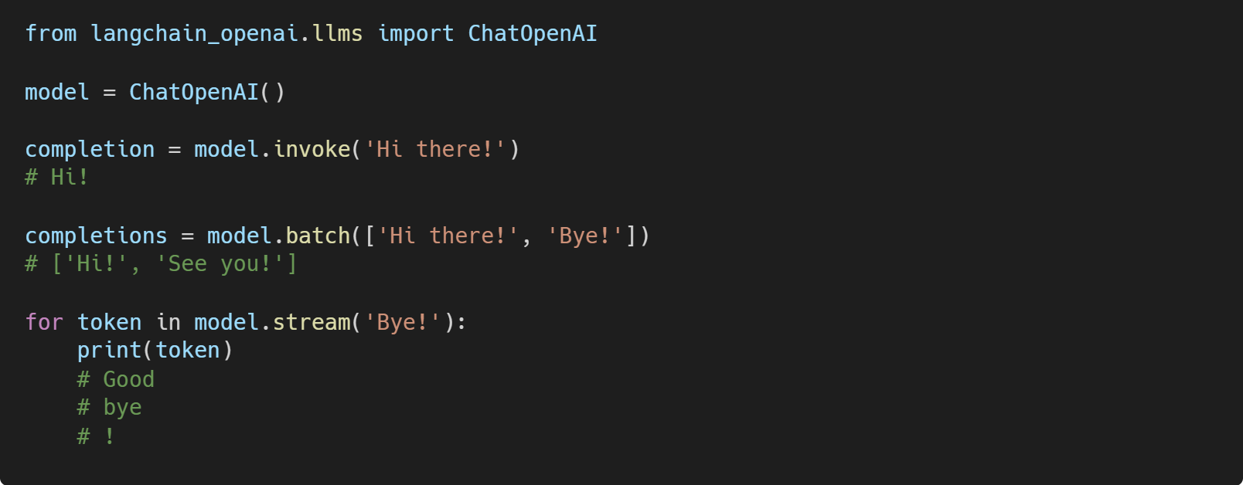
As such, all components behave the same way, and the interface learned for one of them applies to all:

Slide 10
In this example, you see how the three main methods work:
invoke() takes a single input and returns a single output.
batch() takes a list of outputs and returns a list of outputs.
stream() takes a single input and returns an iterator of parts of the output as they become available.
In some cases, where the underlying component doesn’t support iterative output, there will be a single part containing all output.
You can combine these components in two ways:
Imperative
Call your components directly, for example, with model.invoke(...)
Declarative
Use LangChain Expression Language (LCEL), as covered in an upcoming section

Slide 11
Imperative and Declarative Composition
Imperative composition is just a fancy name for writing the code you’re used to writing, composing these components into functions and classes.
LCEL is a declarative language for composing LangChain components. LangChain compiles LCEL compositions to an optimized execution plan, with automatic parallelization, streaming, tracing, and async support.

Slide 12
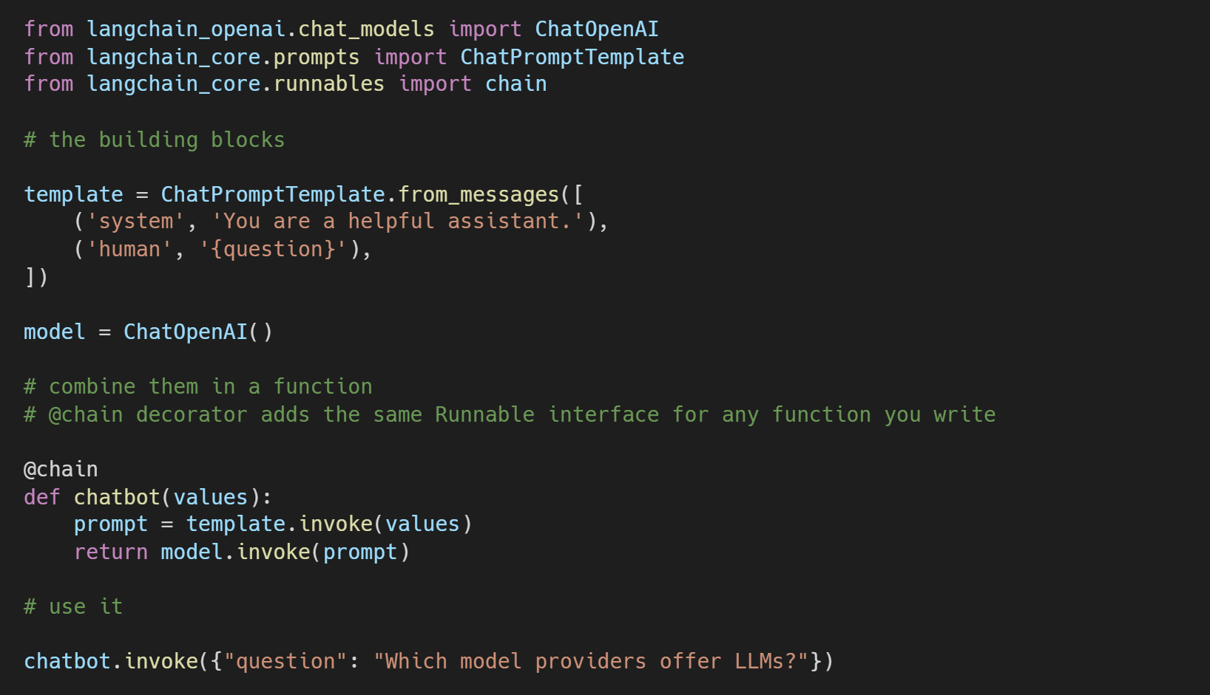
Here’s an Imperative example combining prompts, models, and output parsers:

Slide 13
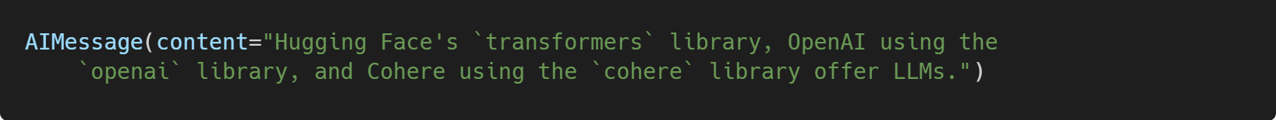
Imperative (cont.)
The preceding is a complete example of a chatbot, using a prompt and chat model. As you can see, it uses familiar Python syntax and supports any custom logic you might want to add in that function.
The output:

Slide 14
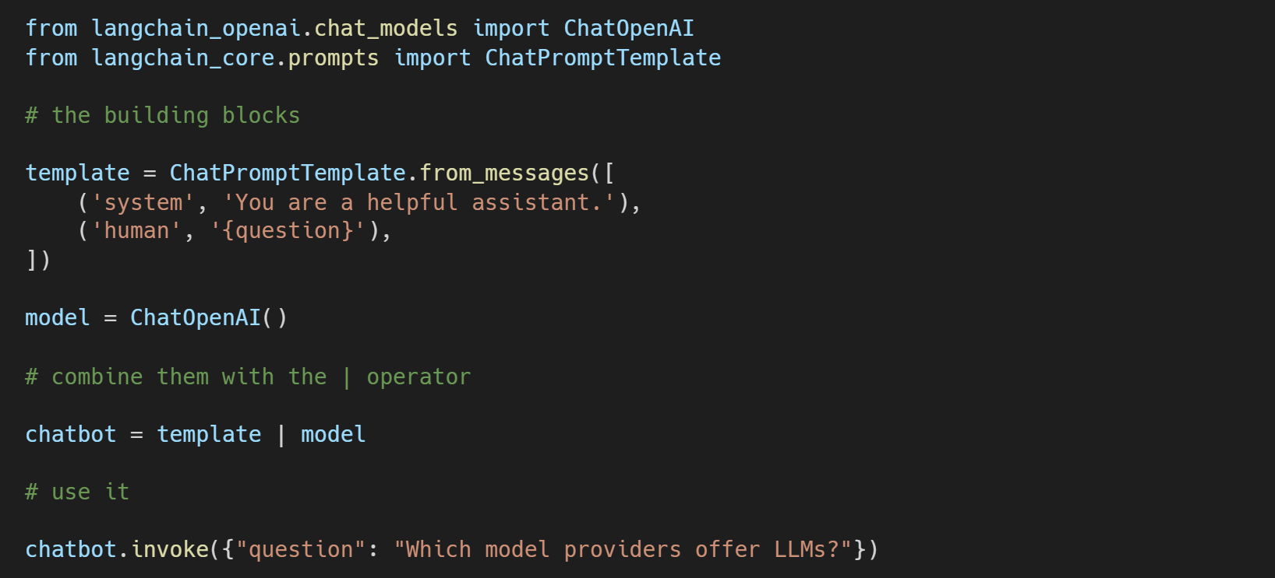
Let’s see the same example using LCEL:

Slide 15
LCEL (cont.)
Crucially, the last line is the same between the two examples—that is, you use the function and the LCEL sequence in the same way, with invoke/stream/batch.

Slide 16
The imperative approach is useful if you intend to write a lot of custom logic, whereas the declarative approach is useful for simply assembling existing components with limited customization.

